Slide 1

Unit 3 Exceptions
By. Dr. Amit.

Slide 2
Exception Handling
Exception handling in Java is a mechanism that allows you to gracefully handle and recover from runtime errors or exceptional conditions that may occur during the execution of a Java program.
It helps prevent the program from crashing and provides a way to handle errors in a controlled manner.
Java exception handling is managed via five keywords: try, catch, throw, throws, and finally.

Slide 3
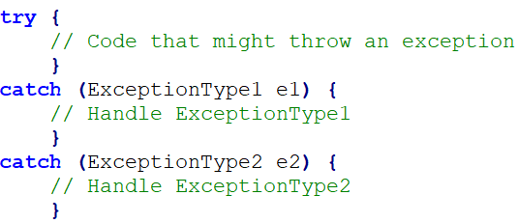
try and catch
Code that might throw an exception is placed inside the try block, and code to handle the exception is placed inside the catch block. Multiple catch blocks can be used to handle different types of exceptions.

Slide 4
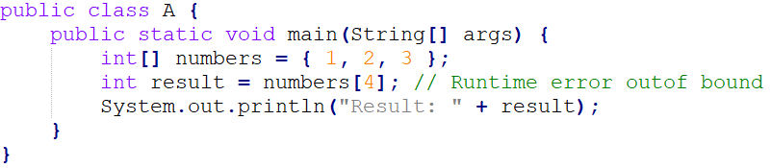
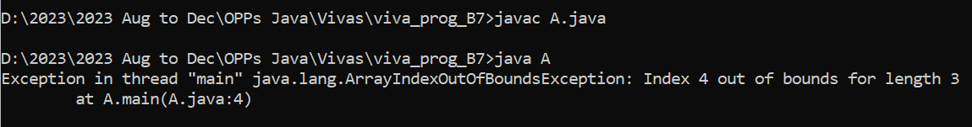
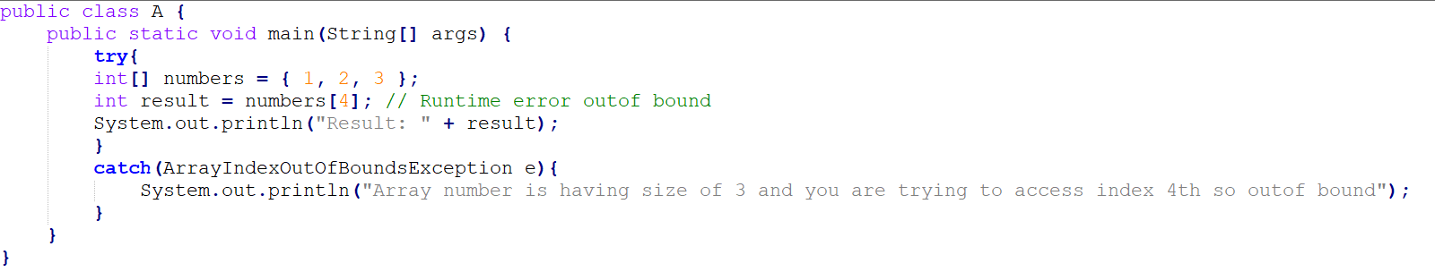
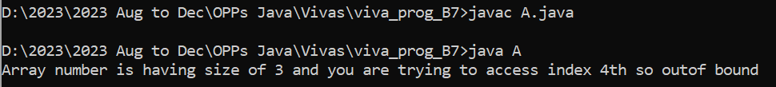
Example 1. Program with out exception Handling

Slide 5
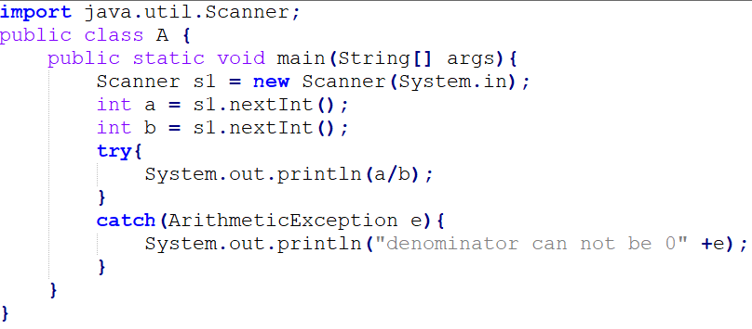
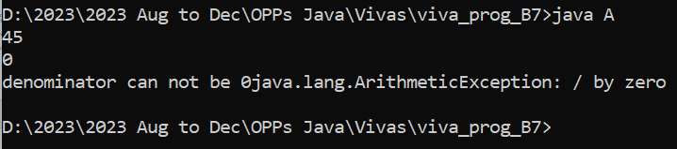
Divide by zero Exception.

Slide 6
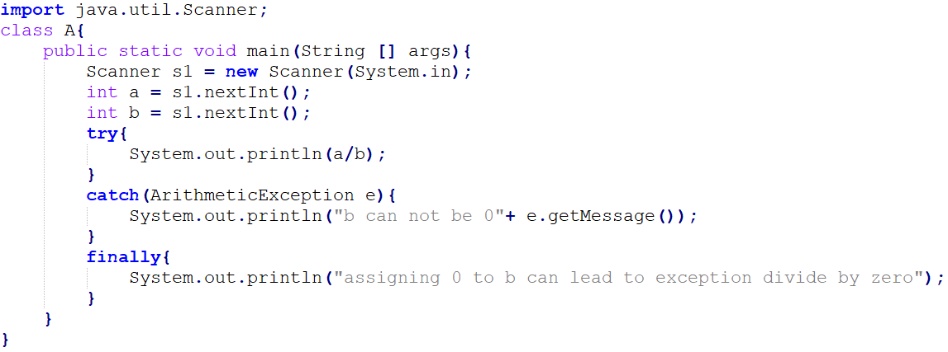
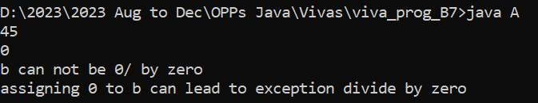
getMassage()

Slide 7
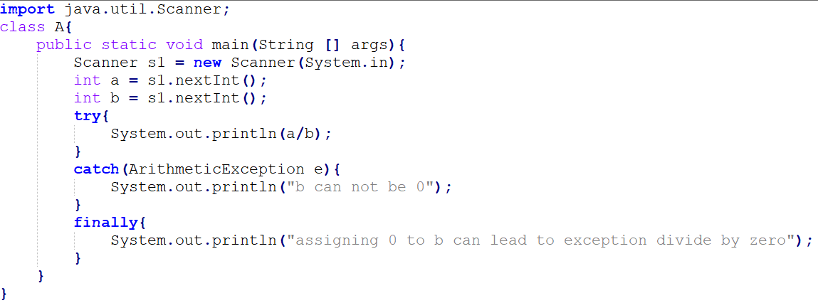
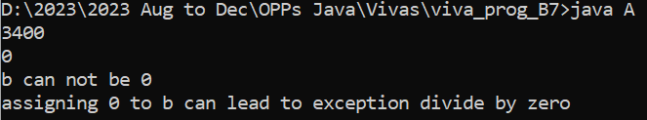
finally
the finally block is used to specify a block of code that will always be executed, regardless of whether an exception is thrown or not.
Any code that absolutely must be executed after a try block completes is put in a finally block.
finally can not be used without try.

Slide 8
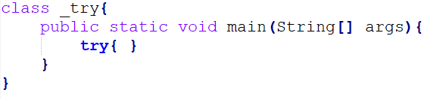
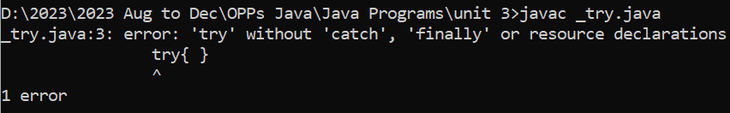
Query
“can we use try without catch or finally”

Slide 9
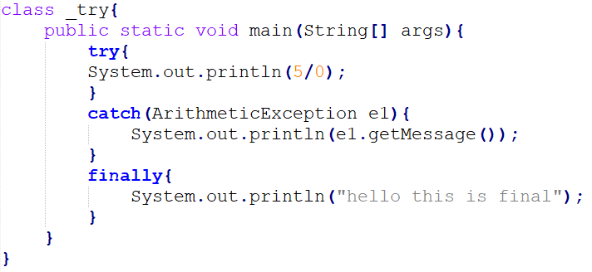
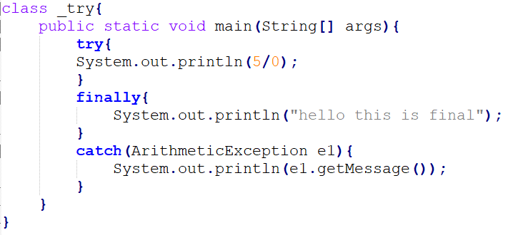

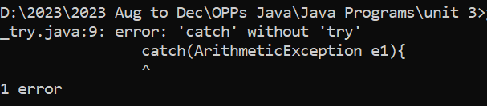
Query
“Can we use try without catch but with finally” – YES
“Can we use catch after finally with try” - NO

Slide 10
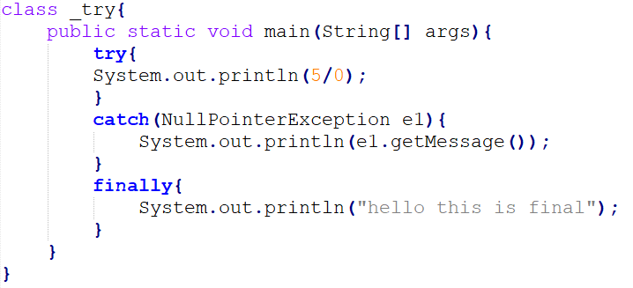
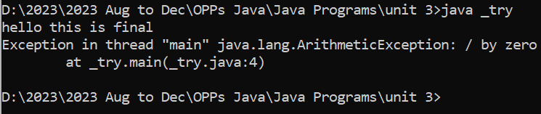
finally will run even if no matching catch is mentioned.

Slide 11
Exceptions
Throwable
Error
Exception
IO Exception
SQL Exception
ClassNotFound Exception
Runtime Exception
Arithmetic Exception
NullPointer Exception
NumberFormat Exception
IndexOutOfBound Exception
ArrayOutOfBound Exception
StringOutOfBound Exception
Checked Exception (compile time)
Unchecked Exception (run time)

Slide 12
Default throw and default catch (java handle exception by itself)
Default throw and user-define catch
User-define throw and default catch
User-define throw and user-define catch

Slide 13
Default throw and user-define catch
try{
}
catch(<exception type><parameter>){
}
finally{
}
//try block should be followed by either catch or finally block.

Slide 14
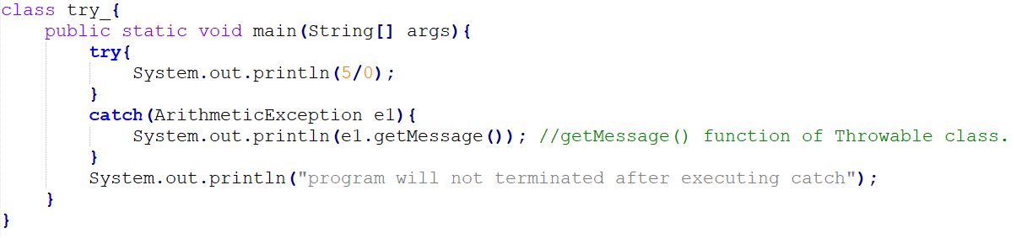
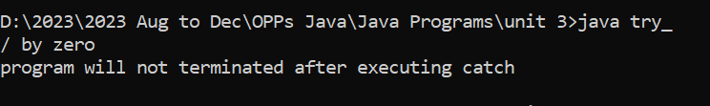
Example

Slide 15
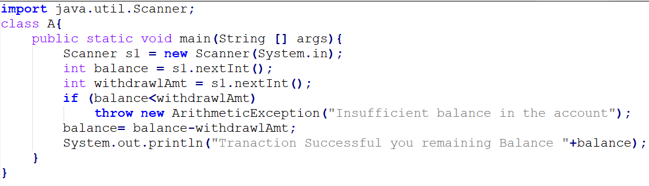
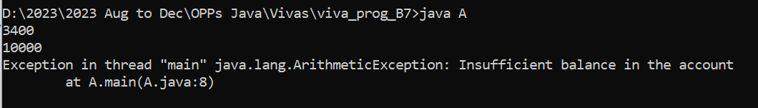
User-define throw and default catch
The throw keyword is used to explicitly throw an exception. It allows you to generate and signal that an exceptional condition has occurred in your program.
We can throw an exception to set different message.
We use the 'throw' keyword to explicitly signal exceptional conditions in Java, even if they are not considered exceptions according to the JVM.

Slide 16
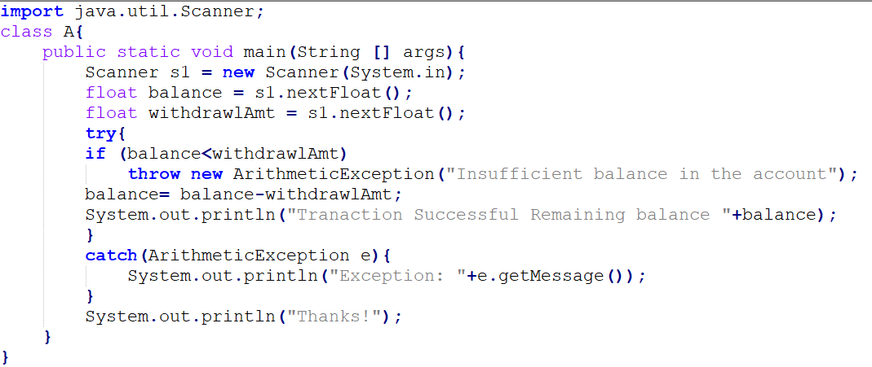
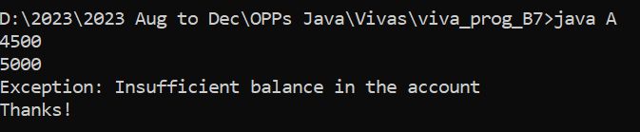
Example : User-defined throw and user-defined catch

Slide 17
Types of Exceptions
Checked Exceptions (Compile-Time Exceptions):
Checked exceptions are exceptions that are checked by the Java compiler at compile time.
Programs are required to either catch (handle) checked exceptions using a try-catch block or declare them using the throws.
Common examples of checked exceptions include IOException, SQLException, and ClassNotFoundException. These exceptions often relate to external factors, such as file I/O, database access, and class loading.
“checked” means they will be checked at the compile-time itself.

Slide 18
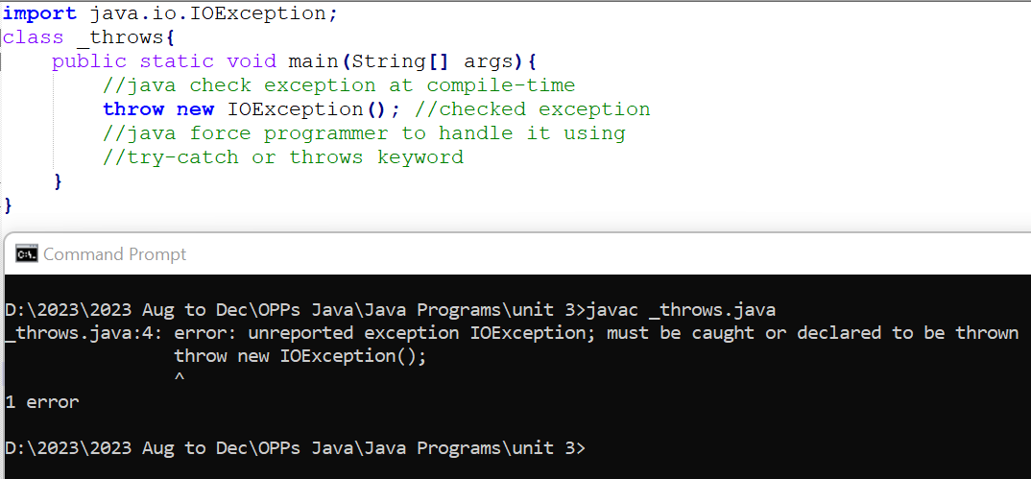
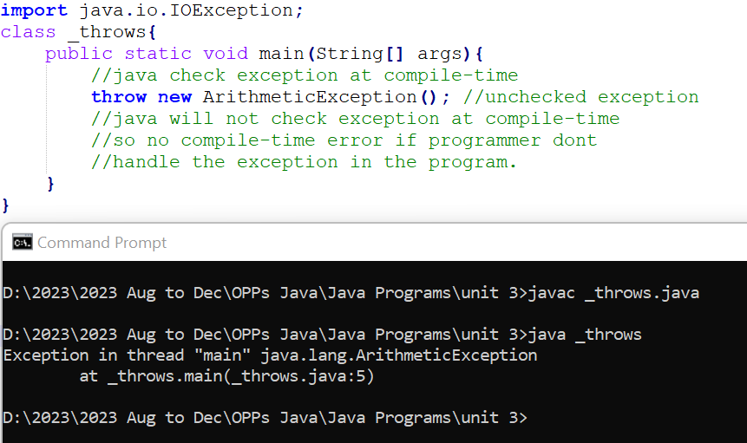

Slide 19
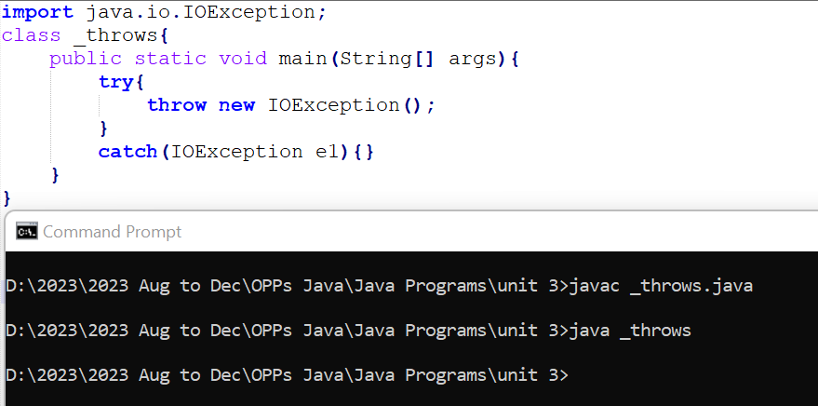
Checked exception handle by the programmer at compile-time using try-catch
By using try-catch programmer is handling the checked exception by its own way.

Slide 20
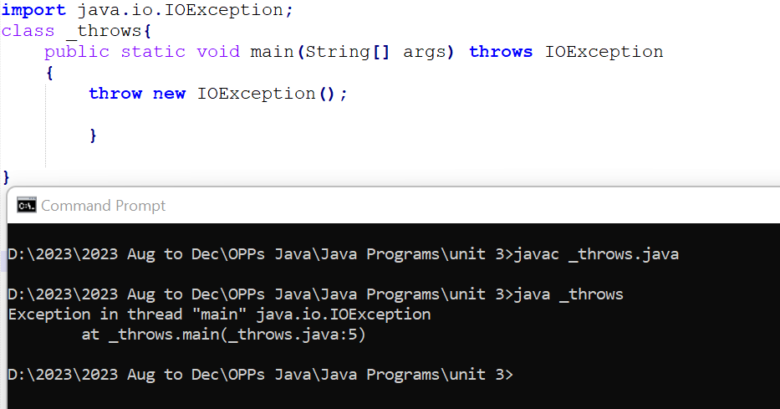
Checked exception handle by the programmer at compile-time using throws keyword
Using throws keyword programmer tell that method may throw one or more exceptions during its execution.

Slide 21
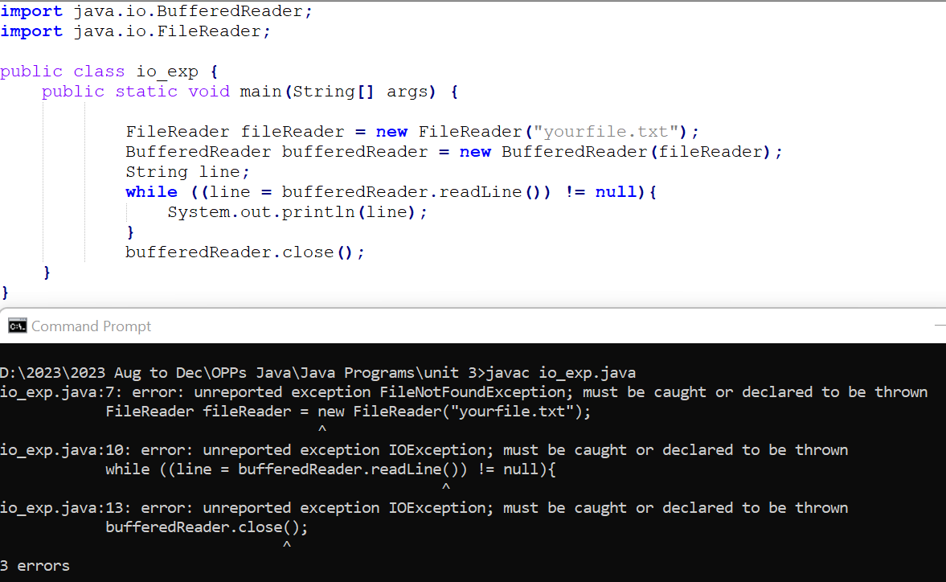
Checked exception - Java compiler will force programmer to deal with the exception that may be thrown.

Slide 22
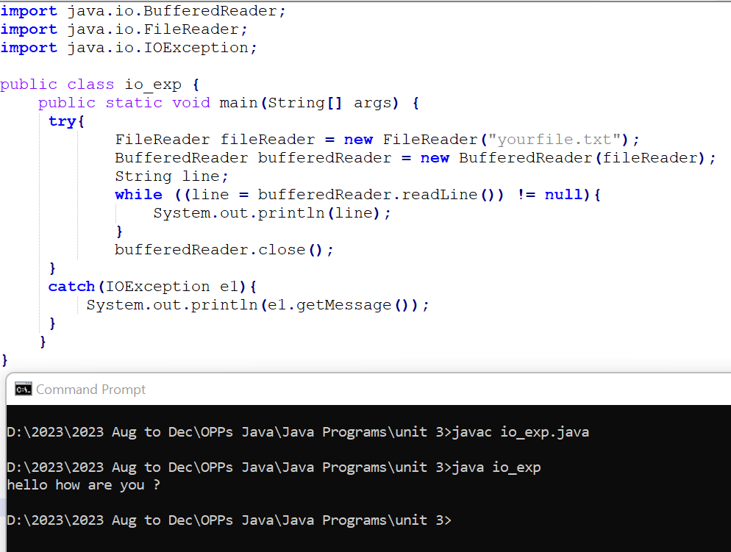

Slide 23
Unchecked Exceptions (Runtime Exceptions):
Unchecked exceptions, also known as runtime exceptions, are exceptions that are not checked by the Java compiler at compile time.
Programs are not required to catch or declare unchecked exceptions. Instead, they are thrown and discovered at runtime.
Common examples of unchecked exceptions include NullPointerException, ArrayIndexOutOfBoundsException, and ArithmeticException. These exceptions often indicate programming errors or unexpected conditions.
Unchecked exceptions are typically used for situations where the error is due to a mistake in the code (such as null references, array index out of bounds, or division by zero) and is not recoverable during normal program execution.

Slide 24
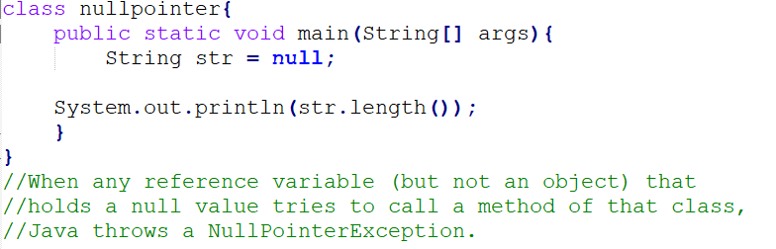
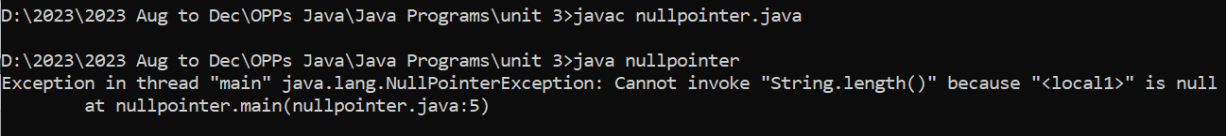
Null Pointer Exception

Slide 25
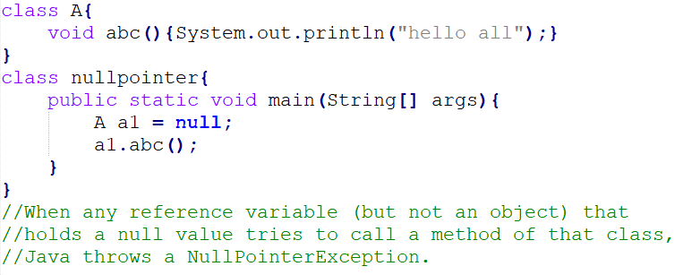
Example 2

Slide 26
Custom exception
Creating a custom exception in Java involves creating a new class that extends either Exception or one of its subclasses.

Slide 27
